Slide 1
5 Advanced Techniques in ML
by evan li

Slide 2
Agenda
Performance Metric matters
Model ensemble
Neural Network and Deep Learning

Slide 3
Homework
Try 10 models on the SF crime model and compare their performance.
Titanic
Send me one test_label.csv

Slide 4
Performance Metric matters

Slide 5
Basic Question
Does our model performs well on training data?
Does our model performs well in validation data?
Does our model performs well in test data?
Does our model performs well in the real world?

Slide 6

Machine learning models in the pipeline
Data Vis
Understand problem
features
Engineering
Choose models
Training With real data
Decide the way to improve
Check the goodness of fit
Perform the prediction

Slide 7
Techniques for model evaluation
Classification metrics: accuracy, recall, F1 score, ROC, AUC, multi-class logarithmic loss
Cross-Validation: to avoid overfitting
Result Visualize: confusion matrix.

Slide 8
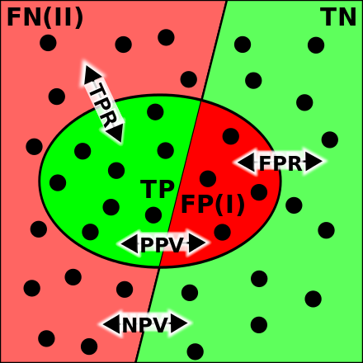
Metrics
Four types of predictions:
TP: true positive
FP:false positive
TN:true negative
FN:false negative
True Positive Rate = Sensitivity
True Negative Rate = Specificity

Slide 9
Confusion Metrics

Slide 10
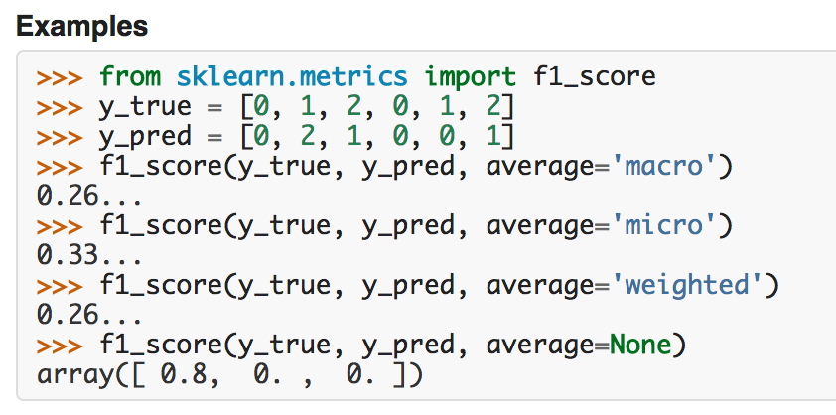
F1 score

Slide 11
Different Scenarios need different metrics
Normal and entry level classification: high Accuracy
Disease Diagnosis: High Accuracy, High Recall
Fraud Detection: High Recall

Slide 12
The Goodness of fit in SKlearn - classification_report
from sklearn import metrics
metrics.classification_report(expected, predicted)

Slide 13
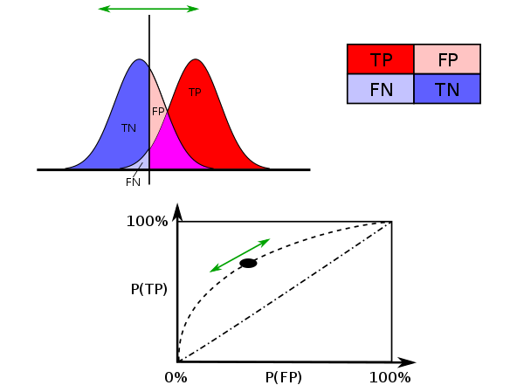
How do we know the goodness of fit?
ROC:receiver operating characteristic curve

Slide 14
Multi-class logarithmic loss

Slide 15
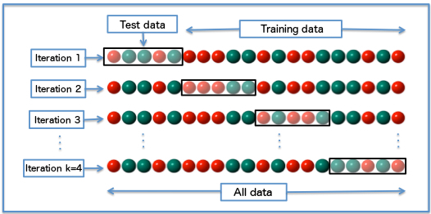
How do we know the goodness of fit? Overfitting
Cross Validation:is a model validation technique for assessing how the results of a statistical analysis will generalize to an independent data set
k-fold Cross Validation

Slide 16
The Goodness of fit in SKlearn - cross validation
from sklearn.model_selection import cross_val_score
clf = svm.SVC(kernel='linear', C=1)
scores = cross_val_score(clf, iris.data, iris.target, cv=5)

Slide 17
Model Ensemble

Slide 19
Ensemble strategy
Averaging Method: the driving principle is to build several estimators independently and then to average their predictions.
Boosting Method: base estimators are built sequentially and one tries to reduce the bias of the combined estimator
http://scikit-learn.org/stable/modules/ensemble.html

Slide 20
Neural Network and Deep Learning

Slide 21
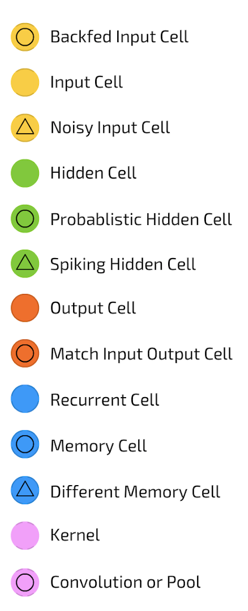
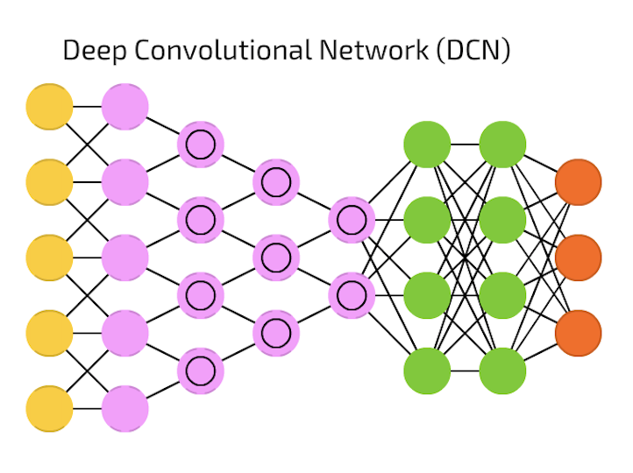
Snapshot-1

Slide 22

Snapshot-2

Slide 23
Snapshot-3
Very Powerful!
But Slow. <= More GPU,CPU <= Better GPU, CPU <= Newer FPGA <= Newer ASIC

Slide 24
Tune Parameter
http://scikit-learn.org/stable/modules/grid_search.html

Slide 25
Partial Fit
partial_fit_classifiers = {
'SGD': SGDClassifier(),
'Perceptron': Perceptron(),
'NB Multinomial': MultinomialNB(alpha=0.01),
'Passive-Aggressive': PassiveAggressiveClassifier(),
}
http://scikit-learn.org/stable/auto_examples/applications/plot_out_of_core_classification.html

Slide 26
Strategies to scale computationally: bigger data
http://scikit-learn.org/stable/modules/scaling_strategies.html

Slide 27
Code Run through in notebook

Slide 28
Homework
Adjust Parameter to get a better score than 8.34
Come up with a evaluation strategy to your SF crime dataset.
Perform the evaluation and compare different models in this new evaluation strategy.
Ensemble your best 3 models.

